Slide 1
GOLDEN RATIO CASE EXPLANATION

Slide 2
CONTENTS OF THIS EXPLANATION
Here’s what we will go through in this presentation:
Firstly, we will see the necessary libraries that has to be imported.
So, we will go through the classes present in our code one by one.
While going through the classes we will see te working of their fucntions like what they are actually doing.
Then we will move towards the end where we will be calling the functions that we have defined in our code.
Finally we will see our main function.

Slide 3
TABLE OF CONTENTS
01
Libraries & Setup
02
Func draw_golden_rect & draw_regression
03
Func display
04
Func display
Explanation of it’s functions in the class such as set, getX ,getY etc
Explanation of it’s functions such as getl, getr, getb etc
Explanation of it’s functions such as set, getb , gett, draw etc
Explanation of it’s functions such as SetWindow, SetViewport etc

Slide 4
LIBRARIES TO BE IMPORTED
OpenGL.GLUT
OpenGL.GLU
1
2
3
4
OpenGL.GL
math

Slide 5
01
Libraries & Setup

Slide 6
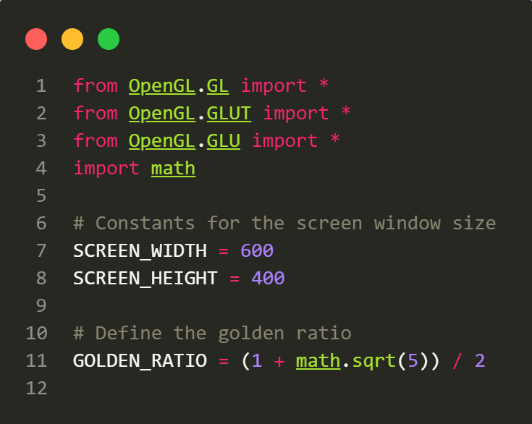

Slide 7
1. Import the necessary OpenGL modules.
2. Define constants for the screen window size: SCREEN_WIDTH and SCREEN_HEIGHT.
3. Define the golden ratio constant as GOLDEN_RATIO.

Slide 8
02
Func draw_golden_rect

Slide 9
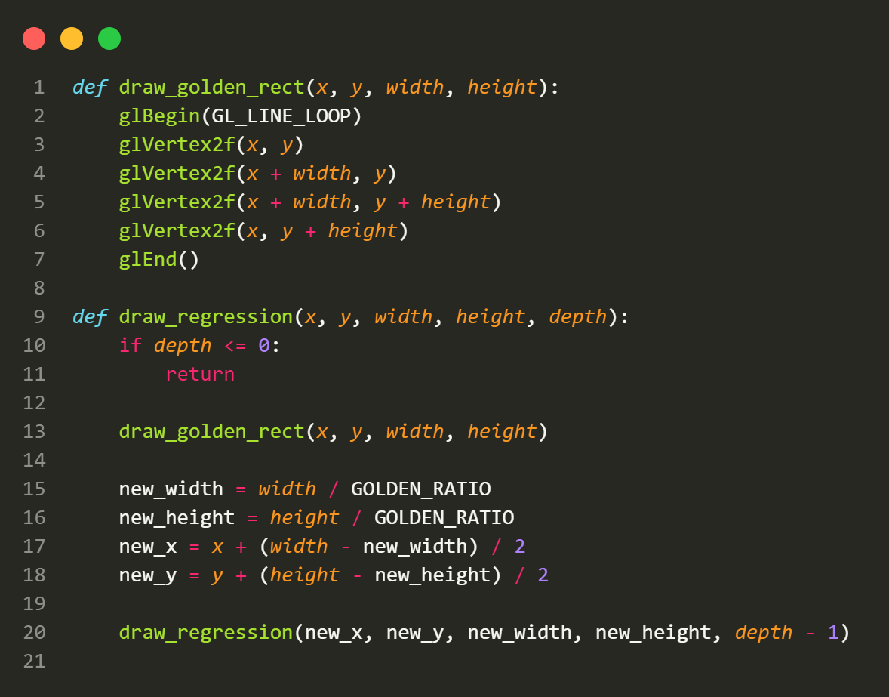

Slide 10
- Define a function draw_golden_rect(x, y, width, height) to draw a golden rectangle outline with the specified position and dimensions using OpenGL.
- Define a recursive function draw_regression(x, y, width, height, depth) to draw a regression of golden rectangles.
- If depth is less than or equal to 0, exit the recursion.
- Draw a golden rectangle at the specified position and dimensions using draw_golden_rect.
- Calculate new dimensions and position for the next smaller golden rectangle based on the golden ratio.
- Recursively call draw_regression with the new parameters and decrement depth.

Slide 11
03
Func display

Slide 12
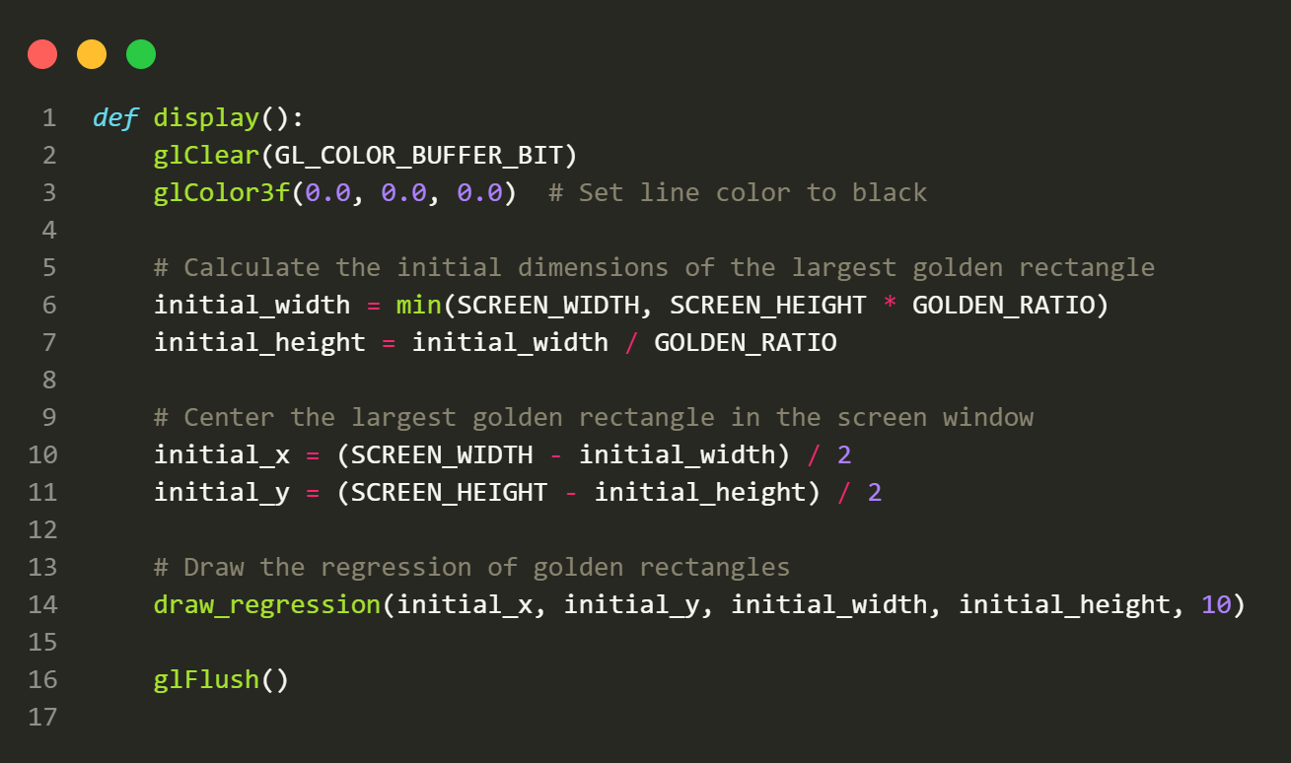

Slide 13
- Define a function display() to set up the OpenGL rendering context:
- Clear the color buffer.
- Set the line color to black.
- Calculate the initial dimensions and position of the largest golden rectangle that fits within the screen dimensions.
- Draw the regression of golden rectangles using draw_regression with initial parameters.
- Flush the OpenGL buffer to display the rendered graphics.
04

Slide 14
04
CLASS reshape

Slide 15
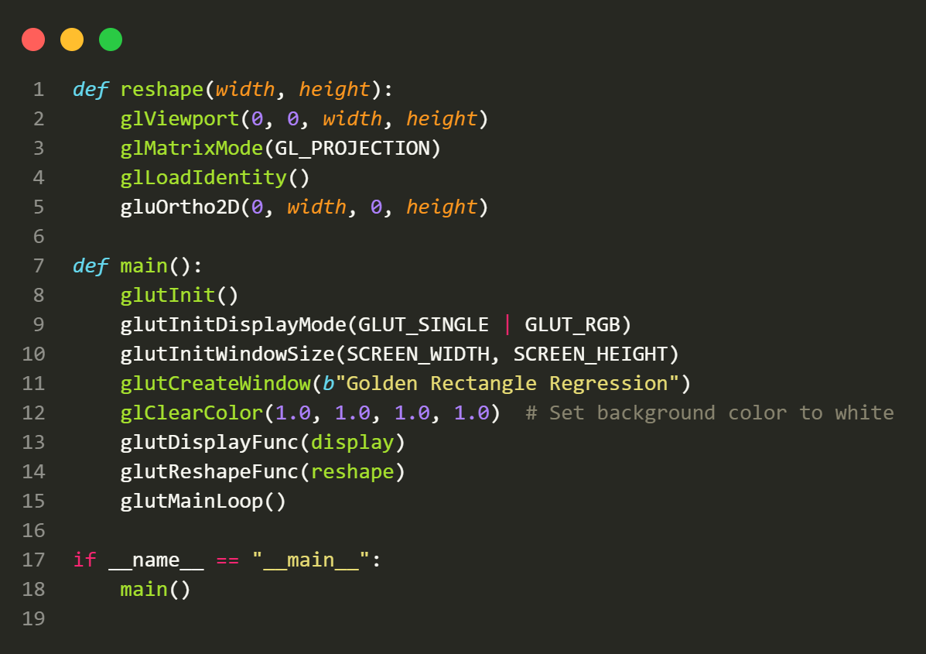

Slide 16
- Define a function reshape(width, height) to handle screen resizing:
- Set the OpenGL viewport to cover the entire window.
- Configure the projection matrix to match the new window size.
- Define the main function main():
- Initialize the GLUT library.
- Configure the display mode to use single buffering and RGB color.
- Set the initial window size.
- Create a window with the title "Golden Rectangle Regression."
- Set the background color to white.
- Specify the display and reshape functions to be used.
- Enter the GLUT event processing loop using glutMainLoop().
- Check if the script is being run as the main program using if __name__ == "__main__”:.
- If it is the main program, call the main() function to start the application.

Slide 17
Now, let's see how the code executes:
- Upon execution, the OpenGL window is created with a white background and displays a series of golden rectangles within it.
- The `draw_regression` function recursively draws smaller golden rectangles within larger ones until the specified depth is reached.
- The display function calculates the initial dimensions and position of the largest golden rectangle that fits within the screen and then invokes draw_regression to draw the series of rectangles.
- Reshaping the window using reshape updates the viewport and projection matrix to match the new window size.
- The main() function initializes GLUT, sets up the window, and enters the event processing loop.
- When the script is run, it displays the golden rectangle regression, which consists of multiple nested golden rectangles. The recursion creates the appearance of rectangles getting smaller and smaller while maintaining the golden ratio.
04

Slide 18
THANK YOU!

